Slide 1
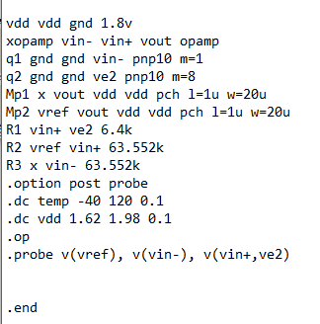
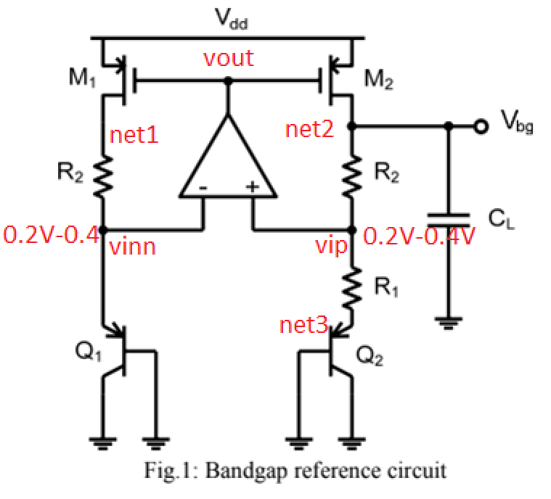
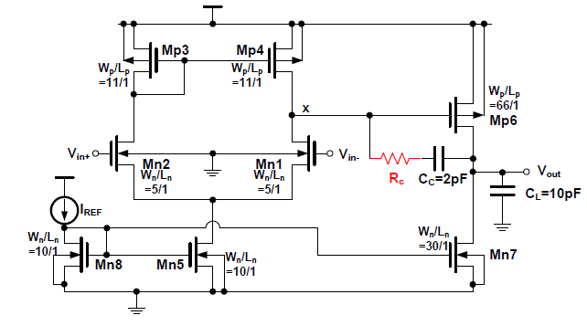
1.8V

Slide 2
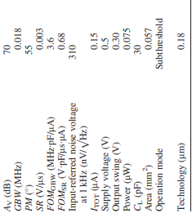
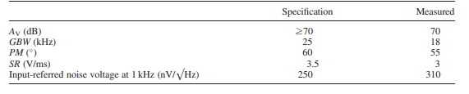
Process Technology | 0.18u
Supply Voltage | 1.8V
Architecture | NMOS input differential pair Two Stage Operational Amplifier
Gain (dB) | 83dB
Phase Margin (deg) | 60°
Unity Gain Bandwidth | >5MHz
PSRR+ | >60dB
PSRR- | >60dB
CMRR | 80dB

Slide 3
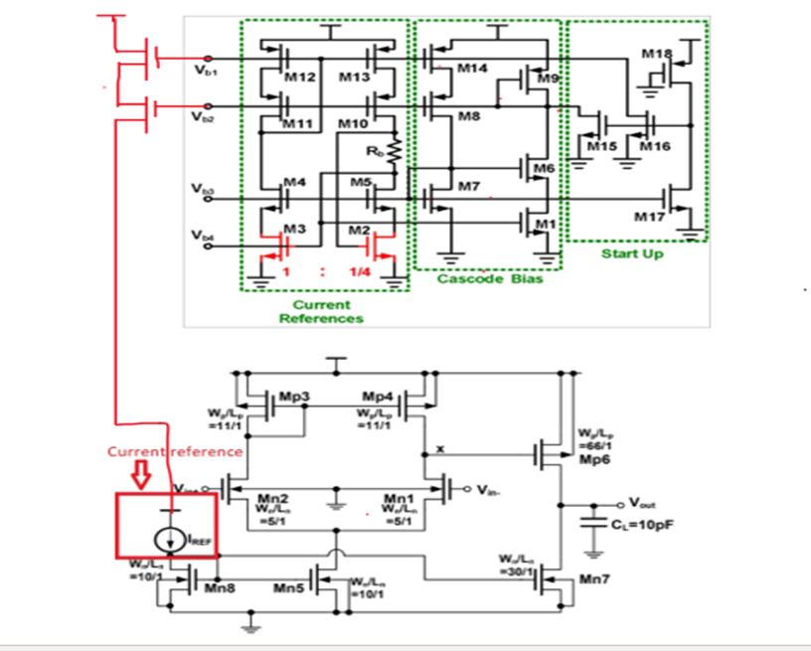

Slide 4
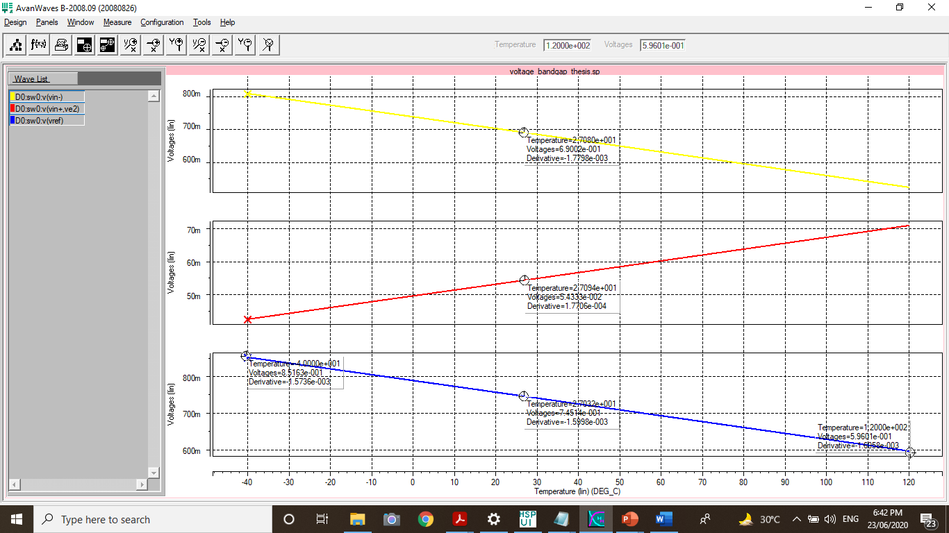
R2=R1=7k

Slide 5

Temperature Coefficient
$$Temp.Coeff=\frac{{Vref}_{max}−{Vref}_{min}}{Temp Sweep ∗Vref @ 27°C}$$
$$Temp.Coeff=\frac{851.63mV−596.01mV}{160°C∗745.14mV}$$
$$Temp.Coeff=2144.06 ppm/°C$$

Slide 6




$$\frac{∂Vref}{∂T}=α1\frac{∂Vbe}{∂T}+α2\frac{∂Vr1}{∂T}$$
$$\frac{∂Vref}{∂T}=0=−1.7798x{10}^{−3}+1.7706x{10}^{−4}(\frac{R2}{R1})$$
$$R2=10.05 (R1)$$
$$R1=R2=70.36 kohm$$

Slide 7
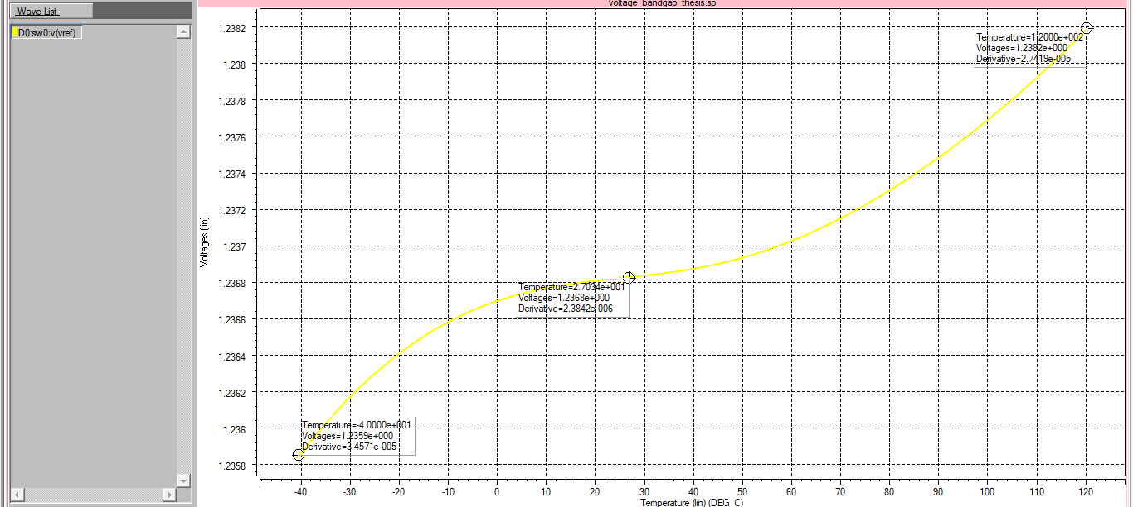

Slide 8
Temperature Coefficient (New)
$$Temp.Coeff=\frac{{Vref}_{max}−{Vref}_{min}}{Temp Sweep ∗Vref @ 27°C}$$
$$Temp.Coeff=\frac{1.2382V−1.2359V}{160°C∗1.2368V}$$
$$Temp.Coeff=11.62 ppm/°C$$

Slide 9




$$\frac{∂Vref}{∂T}=\frac{∂Vbe}{∂T}+\frac{∂VT}{∂T}Ln(n)(\frac{R2}{R1})$$
The ratio of k&q is 8.617333262x10-5, the values obtained from the ratio of R2 and R3 is used to be a reference to obtain the best curvature of the Bandgap voltage reference. Trial and error is done on the next slide using Excel.
$$0=−1.7798x{10}^{−3}+\left(\frac{k}{q}\right)Ln(8) (\frac{R2}{R1})$$
$$\left(\frac{R2}{R1}\right)=\frac{1.7798x{10}^{−3}}{\left(\frac{k}{q}\right)Ln\left(8\right)};k \& q are constant$$
$$\left(\frac{R2}{R1}\right)=9.93$$

Slide 10
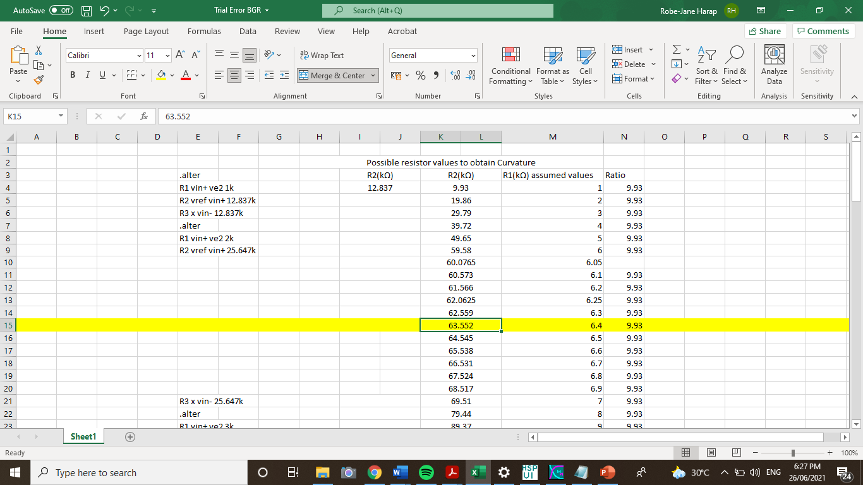

Slide 11
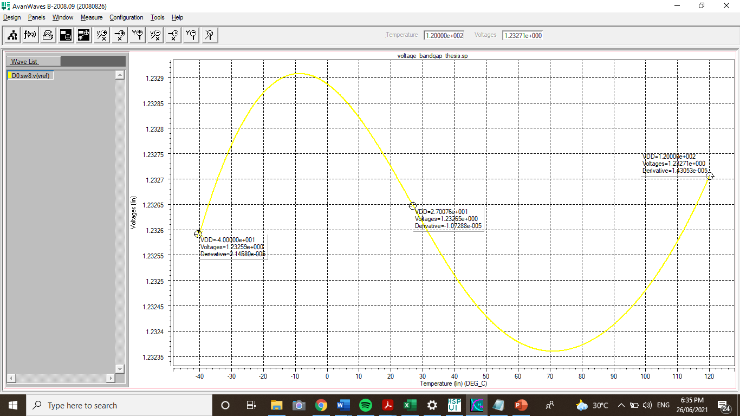

Slide 12
Temperature Coefficient (New)
$$Temp.Coeff=\frac{{Vref}_{max}−{Vref}_{min}}{Temp Sweep ∗Vref @ 27°C}$$
$$Temp.Coeff=\frac{1.23271V−1.23259V}{160°C∗1.23265V}$$
$$Temp.Coeff=0.608 ppm/°C$$

Slide 13
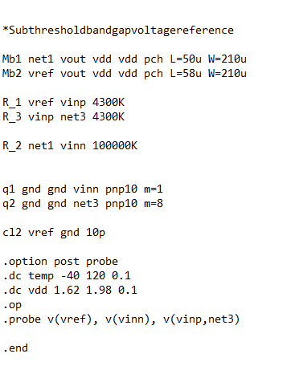
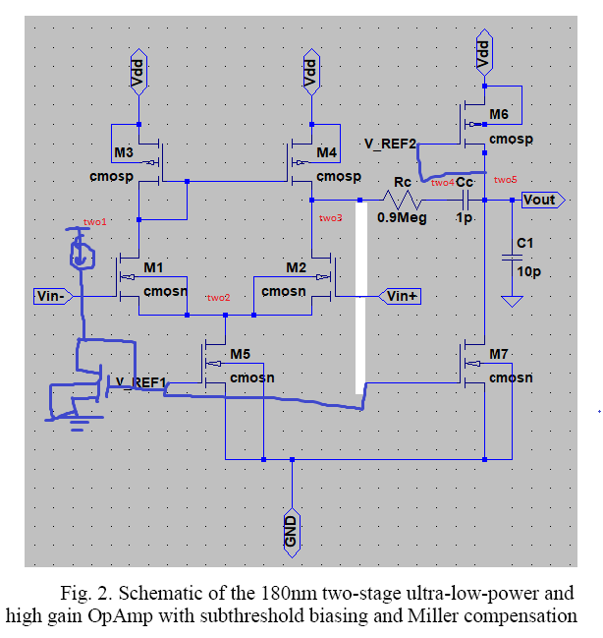
0.8V

Slide 14
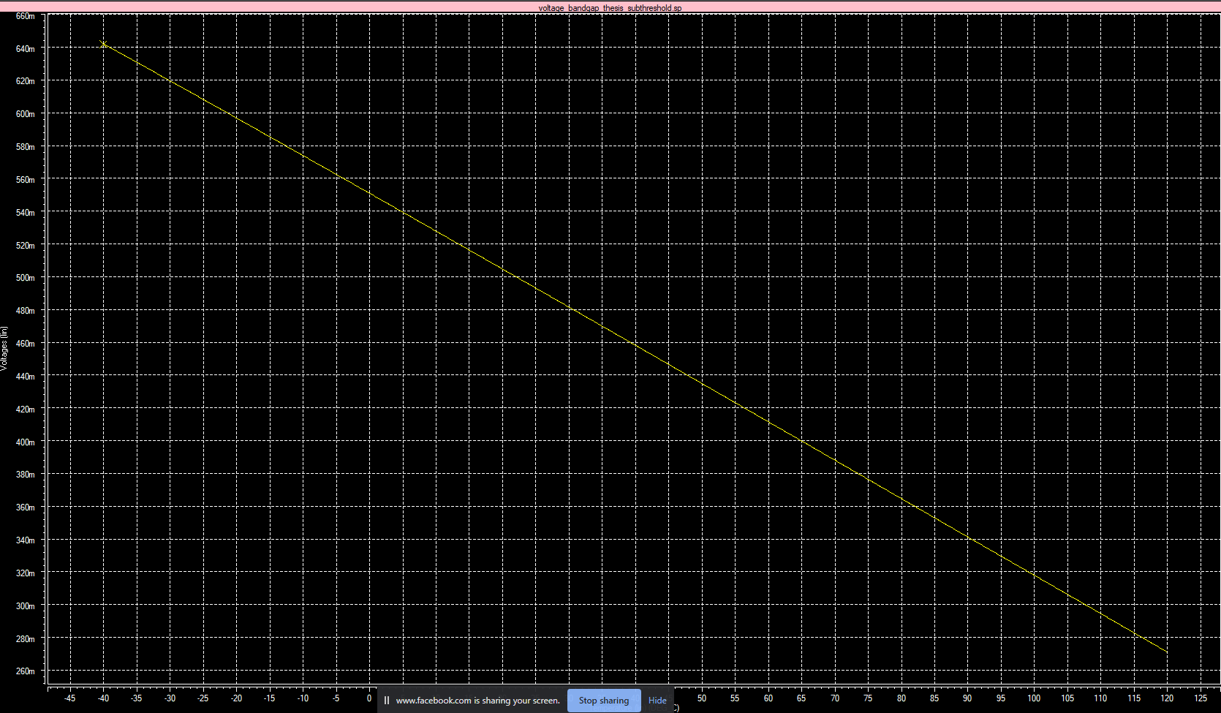

Slide 15
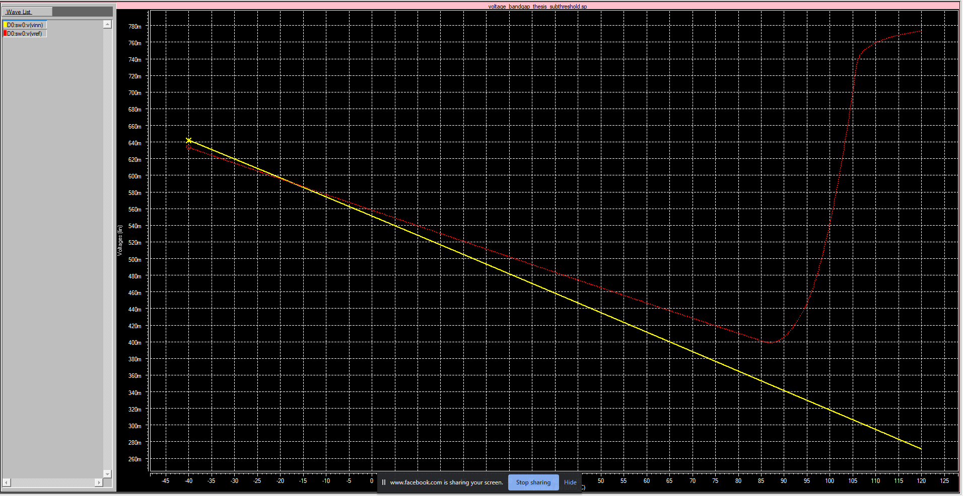

Slide 16
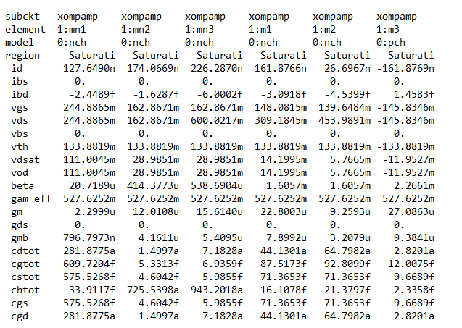

Slide 17
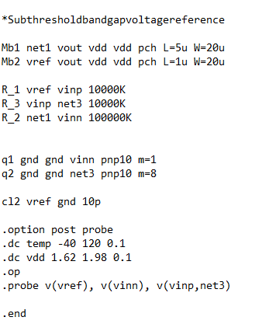
0.5V

Slide 18
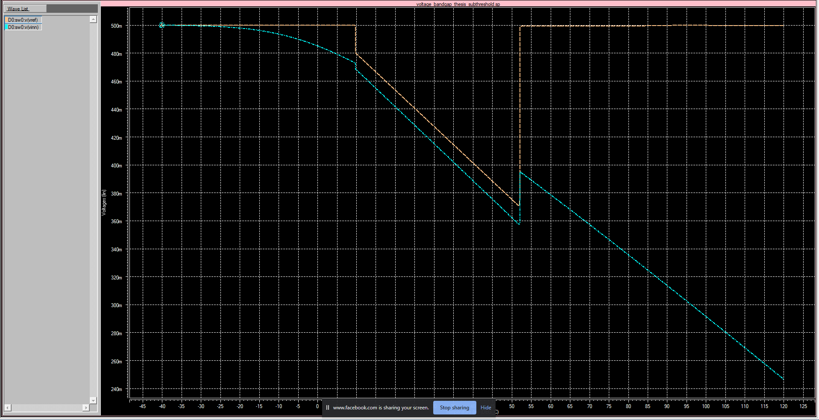

Slide 19
